Slide 1

IICDC 2019 DESIGN PROPOSAL
MODULAR AGRI-BOT
1.CHITLURI PHANEENDRA KUMAR - DESIGN, MECH, ELECTRIC.
2.GANIREDDY MURALI VIKASH - MECH, OPERATIONS
3.YALAMATI YOGITHA DEVI - MARKETING, PROGRAMING
4.ALLURI PRIYANKA - MARKETING, PROGRAMING
5.KODURU SREEKAR - ELECTRIC, PROGRAMING
6.RAVVA GIRIDHAR - MECH , DESIGN
7.KONDREDDY PRANEESHA - MARKETING, OPERATIONS
FACULTY MENTOR: VISHNU KUMAR .S

Slide 2
ABSTRACT:
The main purpose of doing this project is to help the farmers to cultivate their farms in cost effective manner to save time and help them to get good production with less cost.
A Robot with the help of IOT, Cloud Computing, and Big data analysis is designed to perform the various cultivation phases which include 1.Seeding phase (ploughing, seed sowing, drip management, irrigation), 2.Nutrient phase (fertilizers and pesticides distribution, weed removing), 3. Harvesting phase and 4.inspection system. And all these actions will be done the same robot by replacing the modules in each phase of cultivation. This robot has good power management using solar power.
This will help the farmers to perform the activities by simply changing the modules (changing the modules in sense changing the equipment of a tractor).so that the farmers feel less cost of labor and progress of work in less time.

Slide 3
TECHNICAL DETAILS:
PRODUCT BRIEF:
The main core and design innovation of this proposal is that there is one main module and 4 sub-modules in this model. The properties of the module are explained briefly below.
MAIN MODULE:
This is the main module of the robot, which is totally responsible for the movement of the robot. This supports the remaining sub-modules to function. This provides the power , instructions to the sub modules.
MAIN MODULE
MODULE - 1
MODULE - 2
MODULE - 3
MODULE - 4

Slide 4
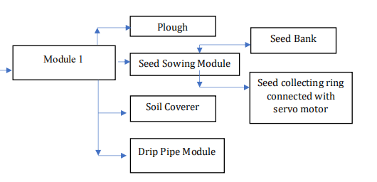
MODULE- 1 :
This module includes seed sowing machine, which sow the seeds. This consists of seed picking buckets which are designed with perfect angle to pick up one seed at a time. So, the single seed is dropped in a single point. In addition to this water tank is fixed such that water can be sprayed on the seed after seed sowing. After sowing and watering, the seed is covered with the soil. So brushes are arranged in a V-shaped manner to cover the soil on the seed.

Slide 5
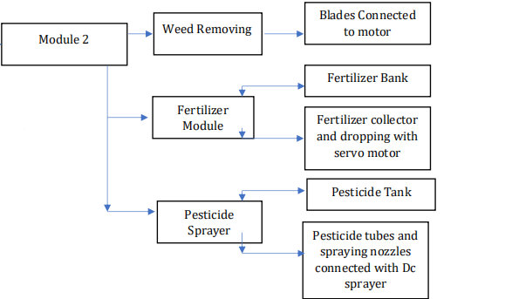
MODULE - 2 :
Generally, for every crop fertilizers and pesticides are mandatory. So in this module 2, three sub-modules are fixed. In this weed remover is fixed at the front to remove the weeds with help of the blades connected to the motor. Now the second sub-module is the fertilizer module. It’s function is to drop the fertilizers along the path of the robot. There is a fertilizer bank in the module from there it collects the fertilizer and drops according to the calculated quantity using servo motor. The third sub-module is the pesticide spraying module. It collects pesticides from the tank and sprays the pesticides around the crop using the dc sprayer and nozzles .

Slide 6
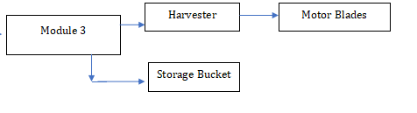
MODULE - 3 :
The main theme of this module is to harvest the crop. This is the major part of the cultivation in which the yield of the crop is calculated in this phase. This module is designed uniquely that blades connected to the motors are arranged at the sides of the agri-bot, such that the time of harvesting is reduced. Storage bucket is designed in such a way that the yield of the crop is collected from the both sides of the robot, to store in the storage bucket.

Slide 7
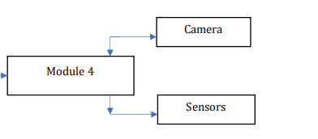
MODULE - 4 :
In the process of cultivation , inspection plays a major role, in which the crop should be examined in frequent intervals of time. It is required to examine the field to know the condition of the crop. so, inspection is done by the robot using camera, soil moisture sensor. Here the camera is fixed in such an angle that the live streaming of the crop is sent to the user using cloud. And the live data’s like soil moisture, temperature, humidity is also sent via cloud for the user.

